Slide 1
Estimating the Autocovariance

Slide 2
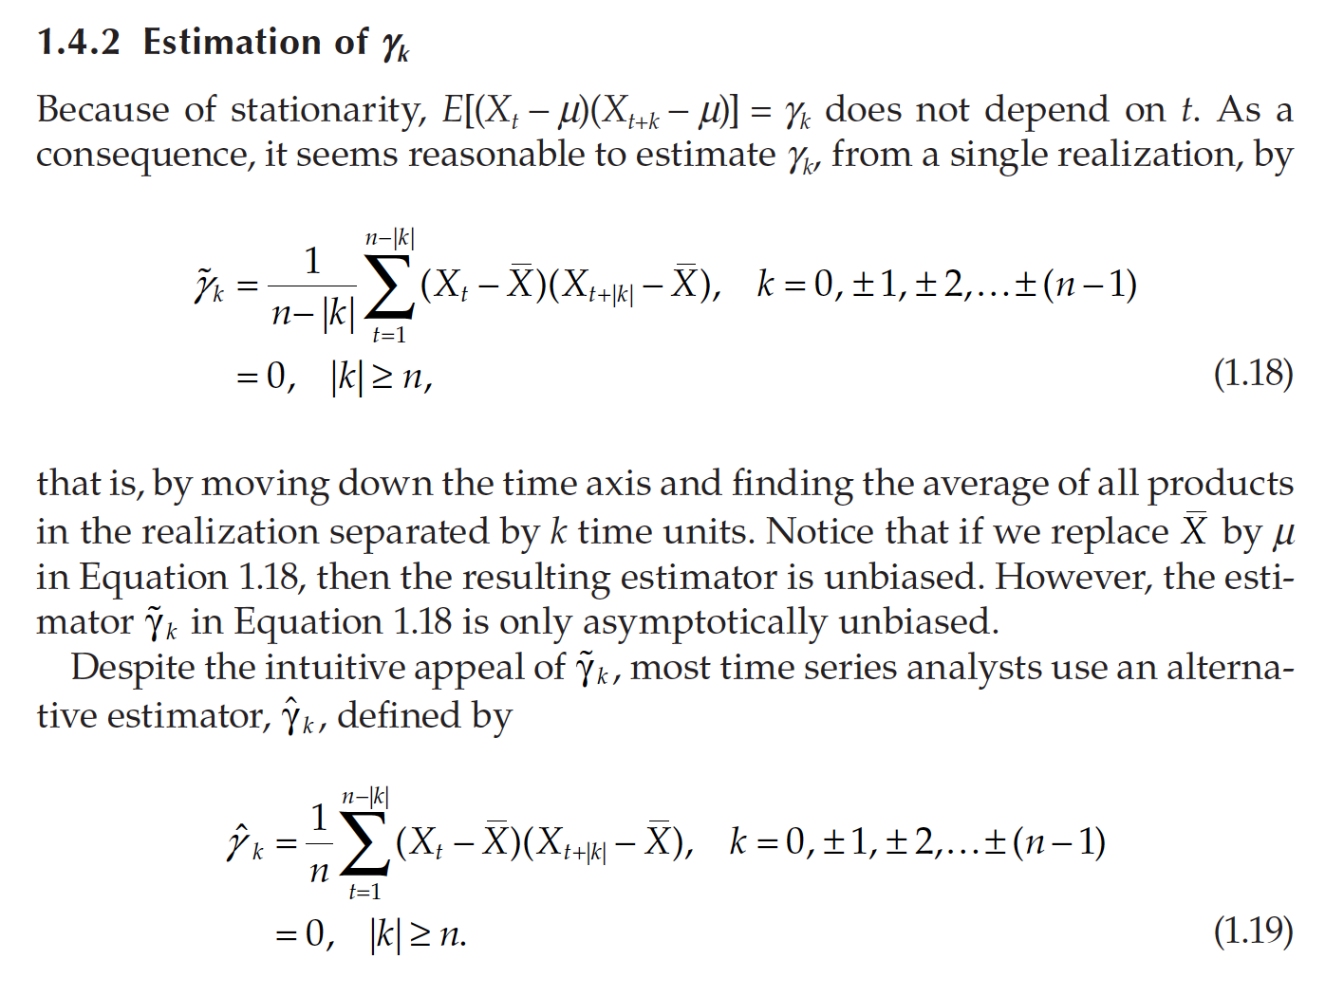
Estimation

Slide 3


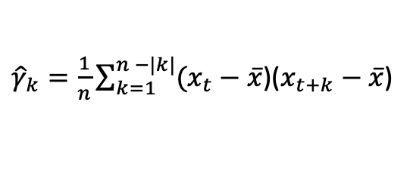


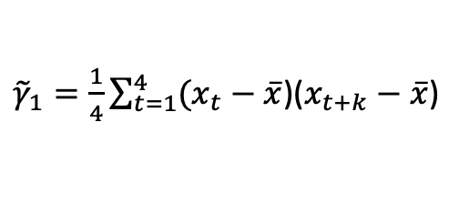
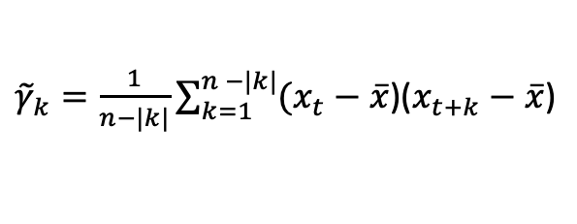

${\tilde{γ}}_{k}=\frac{1}{n−|k|}\sum_{k=1}^{n −|k|}{(x_{t}−}$ $\overline{x}$)($x_{t+k}−\overline{x}$)
Pairs
4
3
2
1
$${\tilde{γ}}_{1}=\frac{1}{4}[\left(14−17\right)\left(15−17\right)+\left(15−17\right)\left(17−17)+\left(17−17\right)\left(20−17\right)+\left(20−17\right)\left(19−17\right)\right]=3$$
$${\tilde{γ}}_{2}=\frac{1}{3}[\left(14−17\right)\left(17−17\right)+\left(15−17\right)\left(20−17)+\left(17−17\right)\left(19−17\right)\right]=−2$$
$${\tilde{γ}}_{3}=\frac{1}{2}[\left(14−17\right)\left(20−17\right)+\left(15−17\right)\left(19−17)\right]=−6.5$$
$${\tilde{γ}}_{4}=\frac{1}{1}\left[\left(14−17\right)\left(19−17\right)\right]=−6$$
Time (t) | X_{t}
1 | 14
2 | 15
3 | 17
4 | 20
5 | 19
${\tilde{γ}}_{1}=\frac{1}{4}\sum_{t=1}^{4}{(x_{t}−}$ $\overline{x}$)($x_{t+k}−\overline{x}$)
${\hat{γ}}_{k}=\frac{1}{n}\sum_{k=1}^{n −|k|}{(x_{t}−}$ $\overline{x}$)($x_{t+k}−\overline{x}$)
Pairs
4
3
2
1
$${\tilde{γ}}_{1}=\frac{1}{5}[\left(14−17\right)\left(15−17\right)+\left(15−17\right)\left(17−17)+\left(17−17\right)\left(20−17\right)+\left(20−17\right)\left(19−17\right)\right]=2.4$$
$${\tilde{γ}}_{2}=\frac{1}{5}[\left(14−17\right)\left(17−17\right)+\left(15−17\right)\left(20−17)+\left(17−17\right)\left(19−17\right)\right]=−1.2$$
$${\tilde{γ}}_{3}=\frac{1}{5}[\left(14−17\right)\left(20−17\right)+\left(15−17\right)\left(19−17)\right]=−2.6$$
$$\overline{x}=17$$
$${\tilde{γ}}_{4}=\frac{1}{5}\left[\left(14−17\right)\left(19−17\right)\right]=−1.2$$

Slide 4
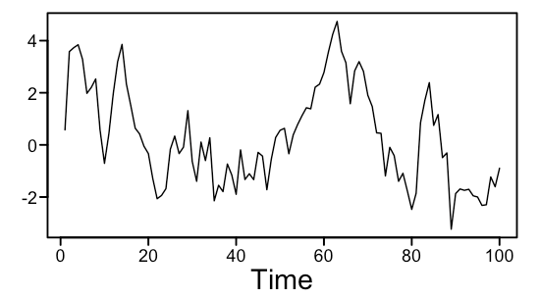
Now let n = 100
set.seed(16)
x = plotts.true.wge(100,.8, vara = 1,lag.max = 100)
gamma_hat = acf(x$data,type = "covariance",lag.max = 100)
gamma_tilde = gamma_hat$acf[2:100]*100 * (1/seq(99,1))
dev.off()
plot(x$acv,type = "l", ylim = c(-3,3), lwd = 3)
lines(gamma_hat$acf,lwd = 2,col = "red")
lines(gamma_tilde, col = "blue", lwd = 2)

Slide 5
Example with R (change seed to see how it changes with different samples.)
set.seed(16)
x = plotts.true.wge(100,.8, vara = 1,lag.max = 100)
gamma_hat = acf(x$data,type = "covariance",lag.max = 100)
gamma_tilde = gamma_hat$acf[2:100]*100 * (1/seq(99,1))
dev.off()
plot(x$acv,type = "l", ylim = c(-3,3), lwd = 3)
lines(gamma_hat$acf,lwd = 2,col = "red")
lines(gamma_tilde, col = "blue", lwd = 2)

Slide 6
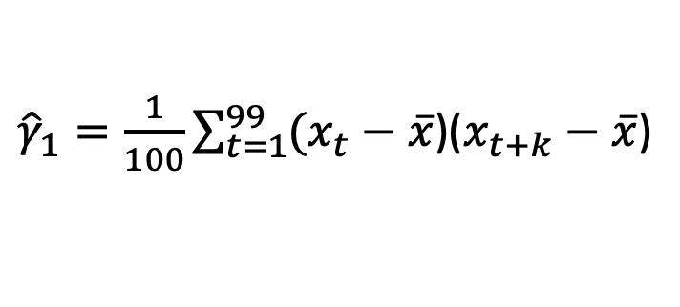
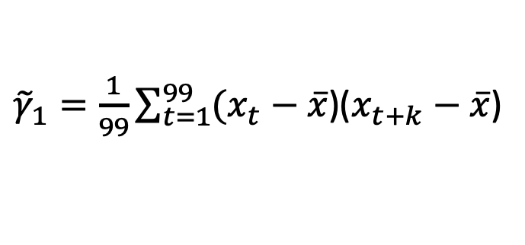
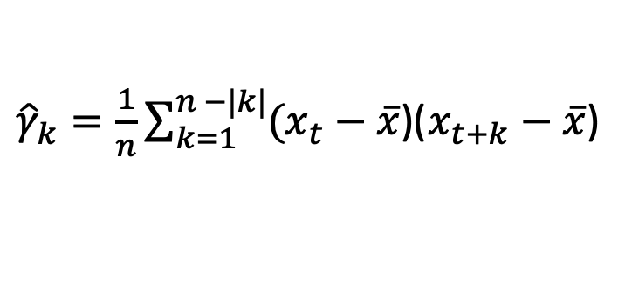
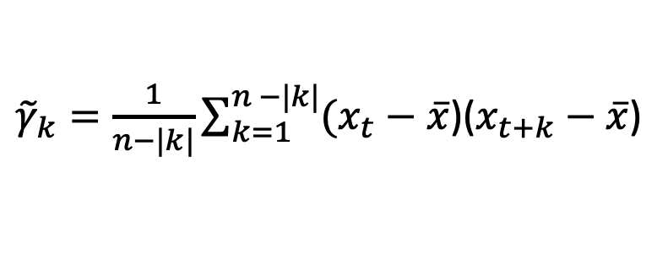
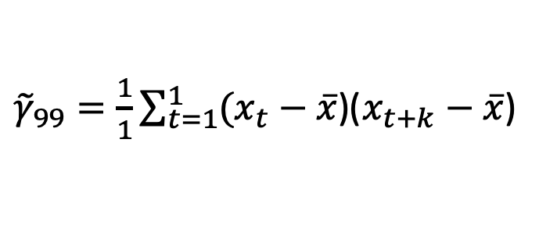
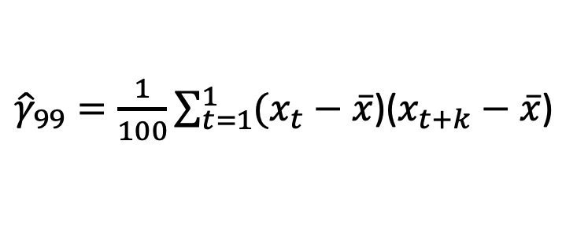
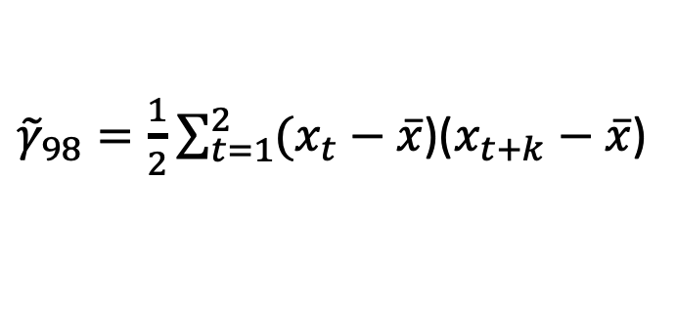
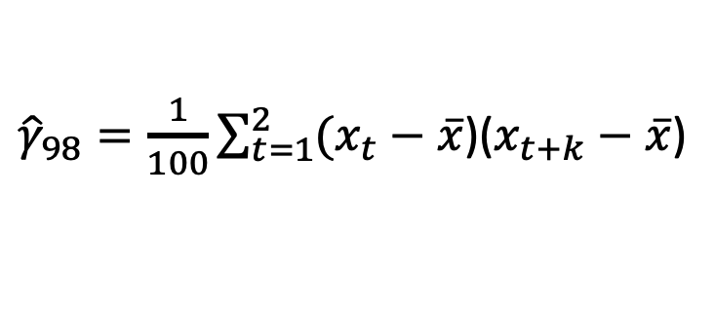
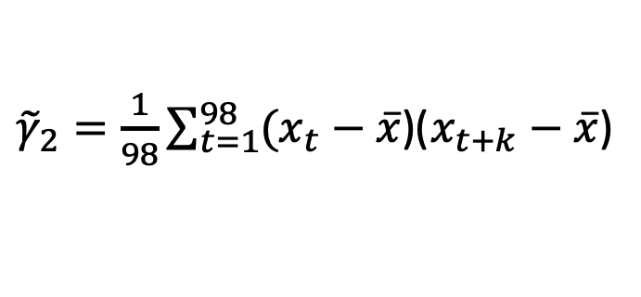
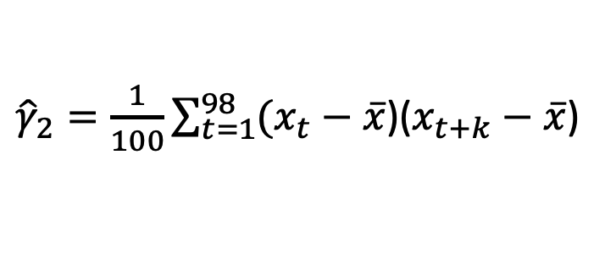
Now let n = 100
${\tilde{γ}}_{k}=\frac{1}{n−|k|}\sum_{k=1}^{n −|k|}{(x_{t}−}$ $\overline{x}$)($x_{t+k}−\overline{x}$)
${\hat{γ}}_{k}=\frac{1}{n}\sum_{k=1}^{n −|k|}{(x_{t}−}$ $\overline{x}$)($x_{t+k}−\overline{x}$)
${\tilde{γ}}_{1}=\frac{1}{99}\sum_{t=1}^{99}{(x_{t}−}$ $\overline{x}$)($x_{t+k}−\overline{x}$)
${\hat{γ}}_{1}=\frac{1}{100}\sum_{t=1}^{99}{(x_{t}−}$ $\overline{x}$)($x_{t+k}−\overline{x}$)
${\tilde{γ}}_{2}=\frac{1}{98}\sum_{t=1}^{98}{(x_{t}−}$ $\overline{x}$)($x_{t+k}−\overline{x}$)
${\hat{γ}}_{2}=\frac{1}{100}\sum_{t=1}^{98}{(x_{t}−}$ $\overline{x}$)($x_{t+k}−\overline{x}$)
…
…
${\tilde{γ}}_{98}=\frac{1}{2}\sum_{t=1}^{2}{(x_{t}−}$ $\overline{x}$)($x_{t+k}−\overline{x}$)
${\hat{γ}}_{98}=\frac{1}{100}\sum_{t=1}^{2}{(x_{t}−}$ $\overline{x}$)($x_{t+k}−\overline{x}$)
${\tilde{γ}}_{99}=\frac{1}{1}\sum_{t=1}^{1}{(x_{t}−}$ $\overline{x}$)($x_{t+k}−\overline{x}$)
${\hat{γ}}_{99}=\frac{1}{100}\sum_{t=1}^{1}{(x_{t}−}$ $\overline{x}$)($x_{t+k}−\overline{x}$)

Slide 7
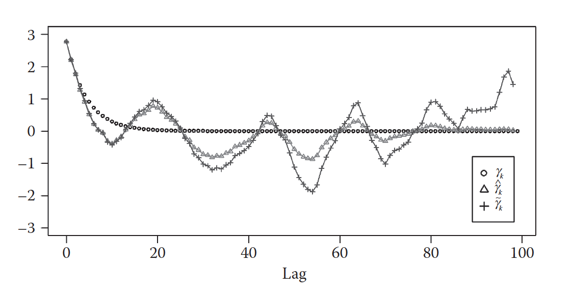
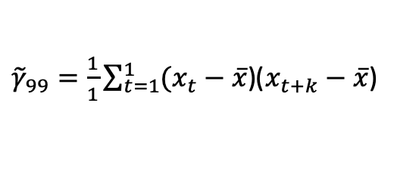
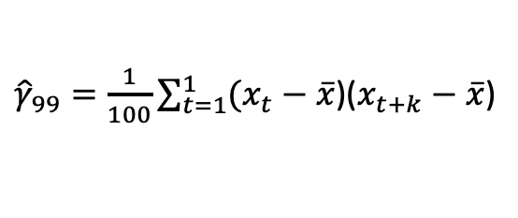
Estimation of Autocovariance
${\tilde{γ}}_{99}=\frac{1}{1}\sum_{t=1}^{1}{(x_{t}−}$ $\overline{x}$)($x_{t+k}−\overline{x}$)
${\hat{γ}}_{99}=\frac{1}{100}\sum_{t=1}^{1}{(x_{t}−}$ $\overline{x}$)($x_{t+k}−\overline{x}$)

